Slide 1
New Kid on the Block
Walter Elias Disney: The Early Years
Notes:
This is a test – can I read this in “Play” mode?

Slide 2
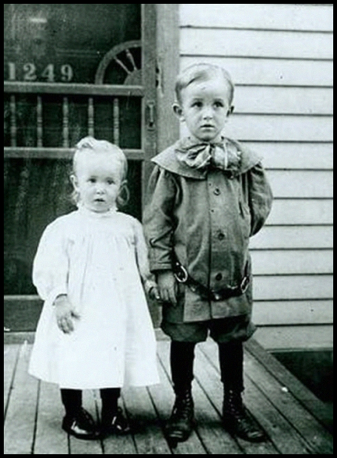
Born December 5, 1901

Slide 3
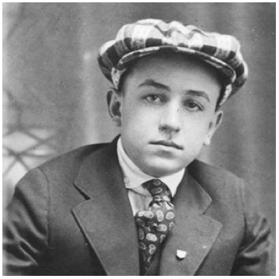
Showed an early interest in the arts: drawing and acting.

Slide 4
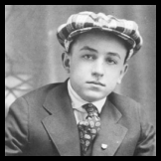

Elias Disney was not financially successful.
Tried various trades.
After selling his Marceline, Missouri Farm, family moved to Chicago.
Acquired a paper route as a principle source of income.
Walt and his brother were delivery boys.

Slide 5
Elias Disney wasn’t supportive of his son’s interests in the arts.
Walt looked to Roy for comfort and companionship.
Childhood friend with mutual interests.
Would sneak out of his bedroom, interact with his neighbors, then climb back in his bedroom window a few hours before he had to go deliver papers.

Slide 6
Sold drawings at a local barber shop.
Started classes at the Chicago Institute of Art.

Slide 7
Sold drawings at a local barber shop.
Started classes at the Chicago Institute of Art.
US enters WWI, Roy enlists.

Slide 8
Walt lies about his age and joins the Army.

Slide 9
Walt lies about his age and joins the Army.
His true age is discovered and he is sent home.

Slide 10
Walt lies about his age and joins the Army.
His true age is discovered and he is sent home.

Slide 11
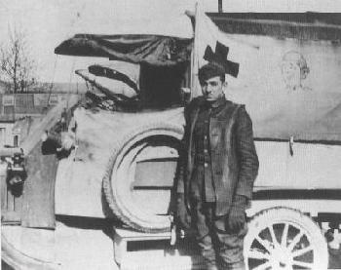
Talks his mom into signing a release so that he can join the Red Cross and drive an ambulance.

Slide 12
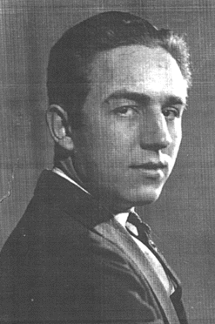
Returns to K. C., finds employment with Pesmin-Rubin Commercial Artists.

Slide 13
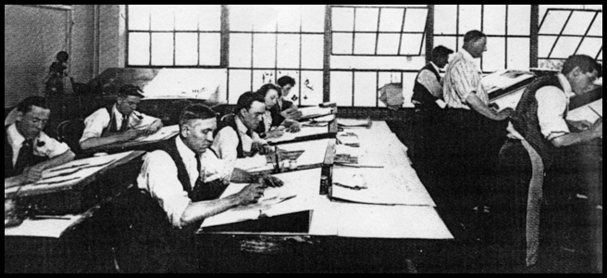
Meets Ubbe Iwwerks at Pesmin-Rubin.

Slide 14
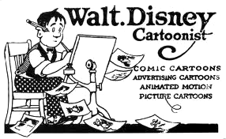
Open A Commercial Art Studio.

Slide 15
Out of Money, Out of Business

Slide 16
Kansas City Film Ad Co.

Slide 17
Kansas City Film Ad Co.
Helps Ub land a job
Introduced to Filmmaking World
And …. Limited Animation Used in Ad Production

Slide 18

Kansas City Film Ad Co.
Acquires Animated Cartoons by Edwin George Lutz from the public library

Slide 19
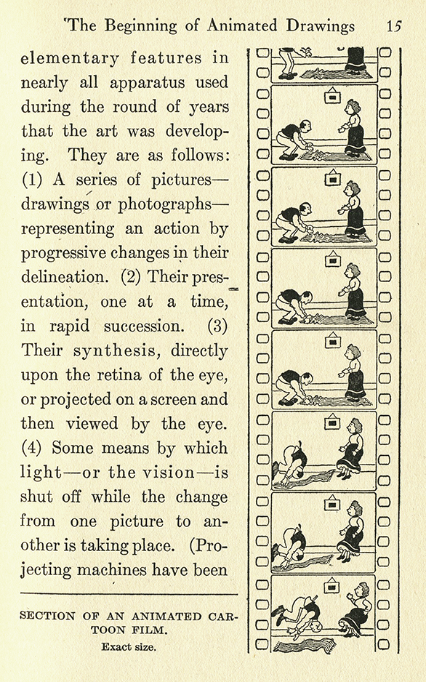
Kansas City Film Ad Co.

Slide 20
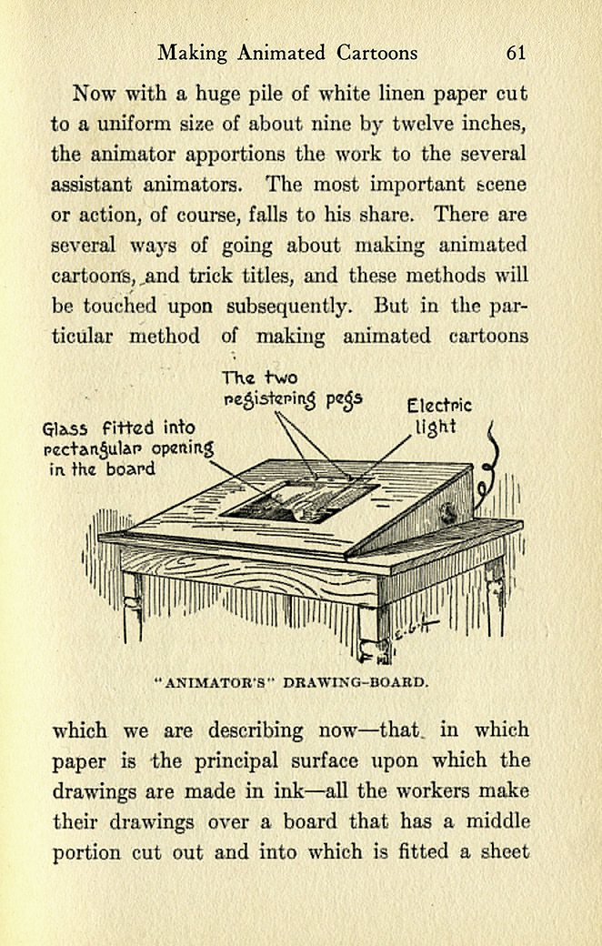
Kansas City Film Ad Co.

Slide 21
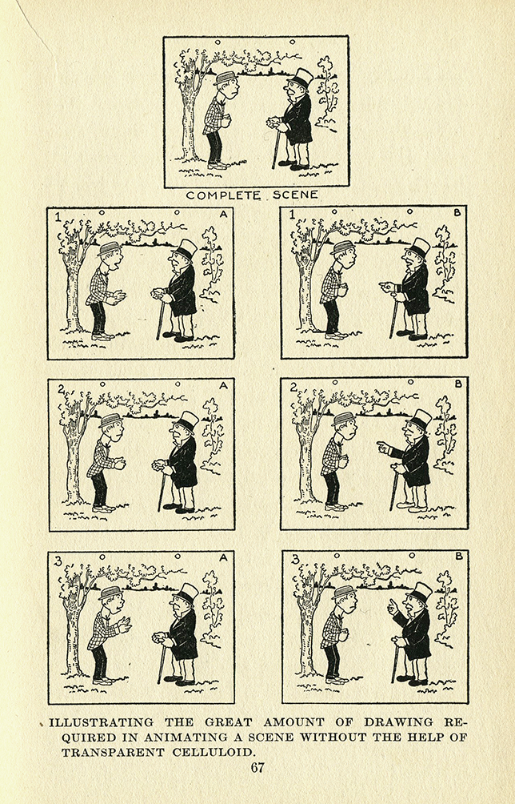
Kansas City Film Ad Co.

Slide 22
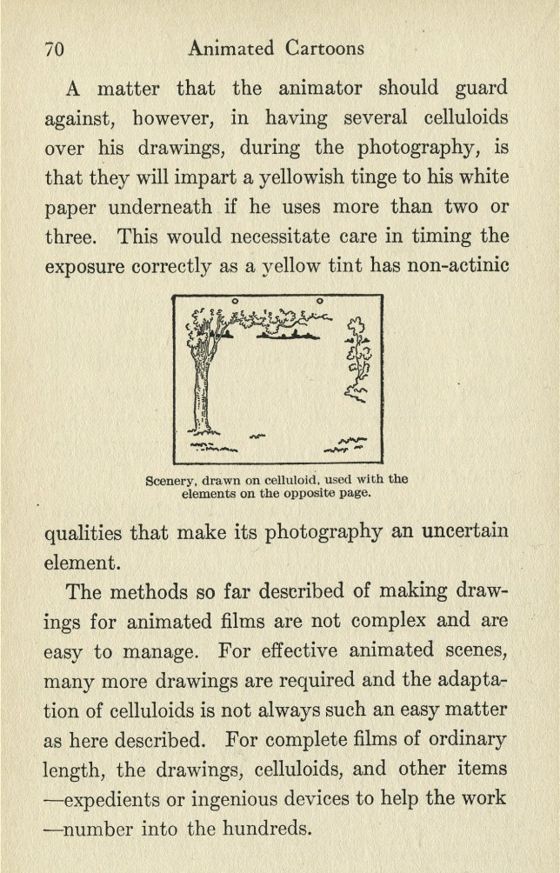
Kansas City Film Ad Co.

Slide 23
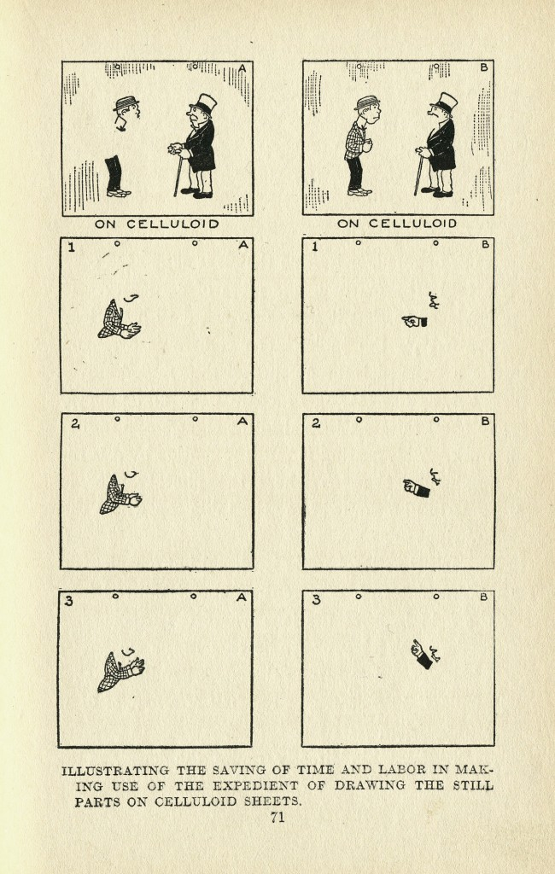
Kansas City Film Ad Co.

Slide 24

Kansas City Film Ad Co.

Slide 25
Kansas City Film Ad Co.
Borrows a camera
Walt & Ub work late nights and weekends

Slide 26
Kansas City Film Ad Co.
Lands an $11,000 contract from Pictoral Films
A Strange Contract: Payment to come six months after delivery

Slide 27
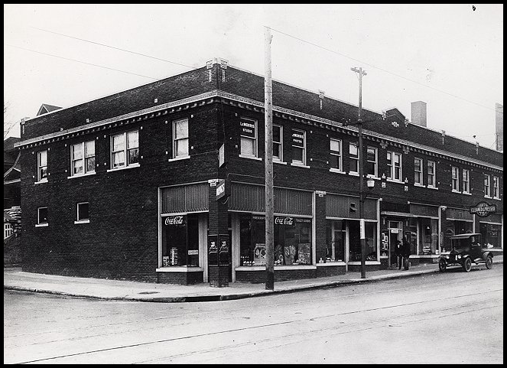
Laugh-o-Grams

Slide 28
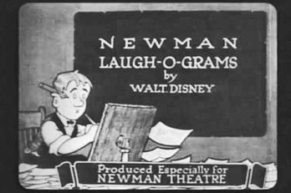
Laugh-o-Grams

Slide 29

Out of Business, Again

Slide 30
“ Perhaps no one in the history of film has had as thorough an understanding of story structure and pacing as Walt Disney”
- Charles Solomon

Slide 31
Disney Brother’s Studio & the Alice Staff, 1927

Slide 32
Walt to M.J. Winkler:
“We have just discovered something new and clever in animated cartoons!
The first subject of this distinctly different series is now in production.
It is a new idea and is bound to be a winner because it is a clever
combination of live characters and cartoons using a cast of live child
actors who carry on their action on cartoon scenes with cartoon characters.”

Slide 33
Walt to M.J. Winkler:
“I am establishing a studio in Los Angeles and am taking with me a select number
of my former staff and will in a short time be producing at regular intervals.”

Slide 34
Walt to M.J. Winkler:
“I am establishing a studio in Los Angeles and am taking with me a select number
of my former staff and will in a short time be producing at regular intervals.”
⬥  
“Believe series can be put over will pay fifteen hundred each negative for first six.”

Slide 35
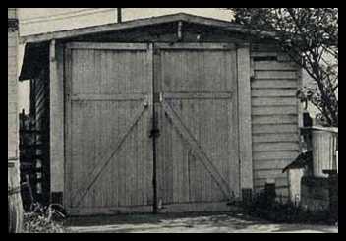
Walt’s Studio, in uncle Roberts’ Garage

Slide 36

Walt’s Studio, in uncle Roberts’ Garage

Slide 37
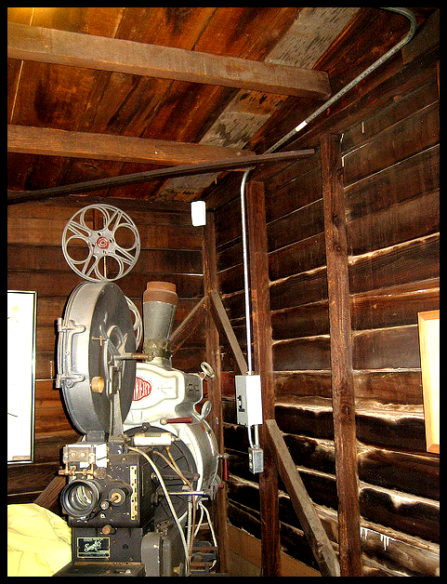
Walt’s Studio, in uncle Roberts’ Garage

Slide 38
Disney Bros. Begins Production
Opens Studio in mid October, 1923
Hires Ham Hamilton
Sends for Virginia Davis, at $100.00 a month
Asks Ub Iwerks to leave K.C. and come to California

Slide 39
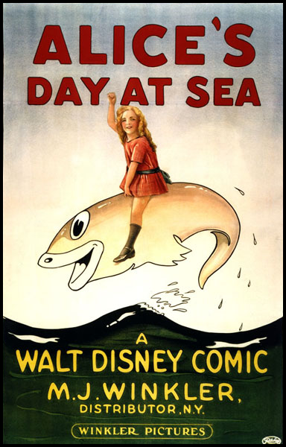
Disney Bros. Begins Production
Released by Christmas 1923

Slide 40
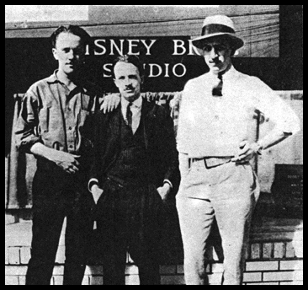
“It didn't take very many people to produce animated cartoons in 1925. Walt Disney, 23, poses outside of his small studio on Kingswell Ave. in Los Angeles with Ub Iwerks (left) and Ham Hamilton (center), both animators. Two girls worked in ink-and-paint, Mike Marcus operated the camera and Walt's older brother Roy handled the books and ran the camera for the live-action filming of the 5 year-old actress, Virginia Davis, who played Alice.”
© The Walt Disney Company

Slide 41
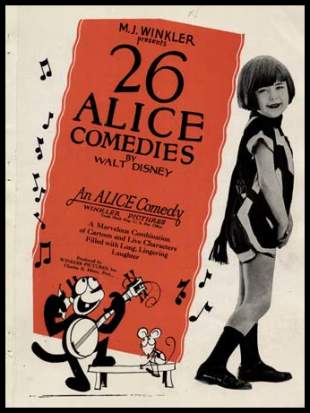
$1,500 each for the first 6, then two more series at $1,800 each.

Slide 42
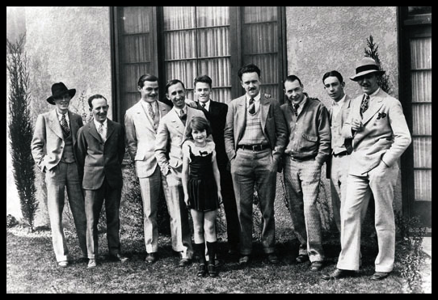
Disney Brother’s Studio & the Alice Staff, 1927

Slide 43
L to R: Walker Harmon, Friz Freleng, Rudolph Ising,
Roy Disney, Lois Hardwick, Hugh Harmon, Ub Iwerks,
Norman Blackburn, Paul Smith, Walt Disney

Slide 44

Oswald the Lucky Rabbit, 1927

Slide 45
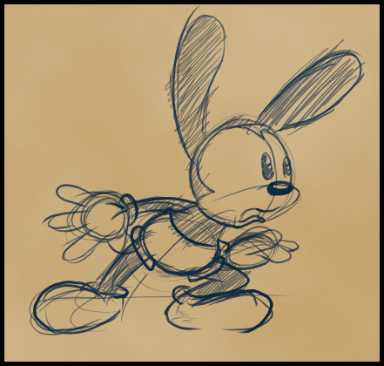
Iwerks redesign was rounder

Slide 46


Comparative Design: Oswald and the Animaniacs

Slide 47
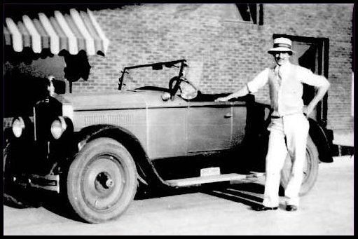
Walt’s one obsession purchase

Slide 48
Mintz
At contract’s end, Mintz was paying Disney Bros.$2,250.00 per cartoon
Walt wanted $2,500.00
Mintz final offer was $1,800.00
or loose his Oswald character altogether

Slide 49
The Coming of Mickey
Ideas began on the train from New York to L.A.
Continued development after his return
Mortimer was his suggested name
Lilly (by most accounts) thought Mickey was better

Slide 50
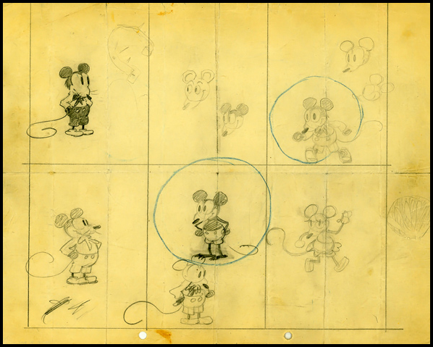
The Coming of Mickey

Slide 51
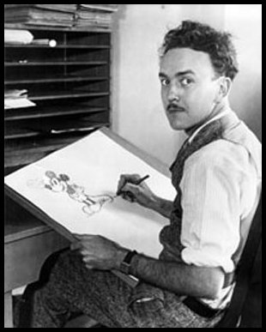
The Coming of Mickey

Slide 52
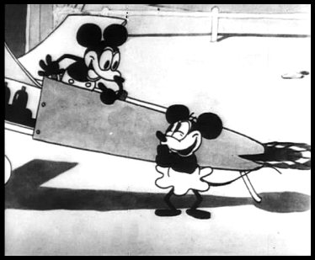
Plane Crazy
Premiered May, 1928

Slide 53
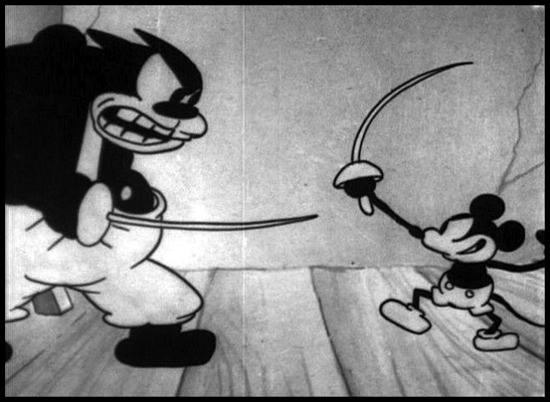
Galloping Gaucho
August, 1928

Slide 54
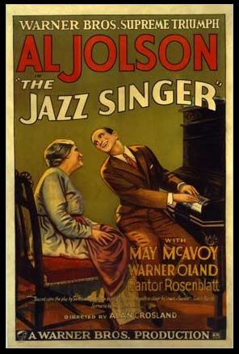
The Jazz Singer, Oct ‘27

Slide 55
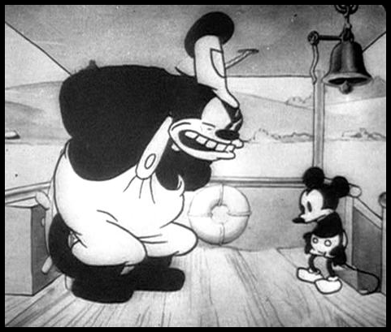
Steamboat Willy

Slide 58
Why would Walt want to take on such a task?
The financial limitations of cartoon shorts.
The Great Depression
Wanting to avoid complacency
Deliver a swift “kick in the pants” to his studio.

Slide 59
“I just felt I had to diversify my business and get into these other things.”

Slide 60


Slide 61
“Other Things”

Slide 62
“Other Things”
Ramp up his operation
Staff and Facilities

Slide 63
“Other Things”
Ramp up his operation
Staff and Facilities
Mature the studio – learn how to do it.
Technical Expertise

Slide 64
“Other Things”
When?

Slide 65
“Other Things”
How?
People
Technical Ability
Animation Maturity

Slide 66
“Other Things”
Why Snow White?
Aesthetic Capabilities

Slide 67
“Other Things”
The Making of Snow White – the Rest of the Story

